Slide 1
Unlocking Cool
in Databases (and CS in general)
or How To Inspire 8th Graders to Go Study the Same Thing I did…
Rimma V. Nehme
Microsoft Jim Gray Systems Lab
graysystemslab.com

Slide 2
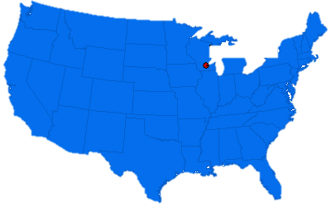
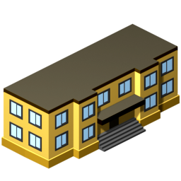
Every Year
Madison, WI
1
2
3
4
Middle School A
Middle School C
Middle School D
Middle School B

Slide 3
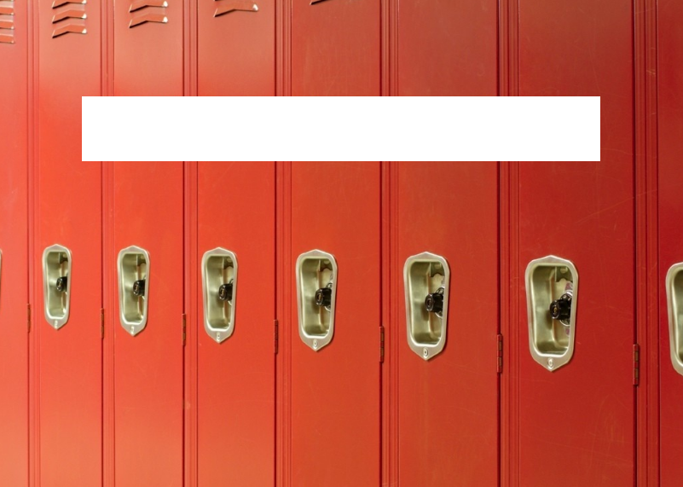
WHY?

Slide 4

Today’s Subject:
Go Study Databases, Kids!
On a more serious note, middle school is when students
(girls in particular)
lose interest in Computer Science and Math

Slide 5
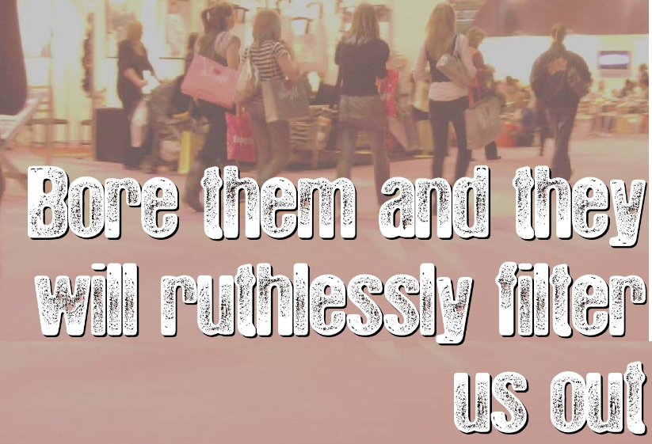
YOU

Slide 6
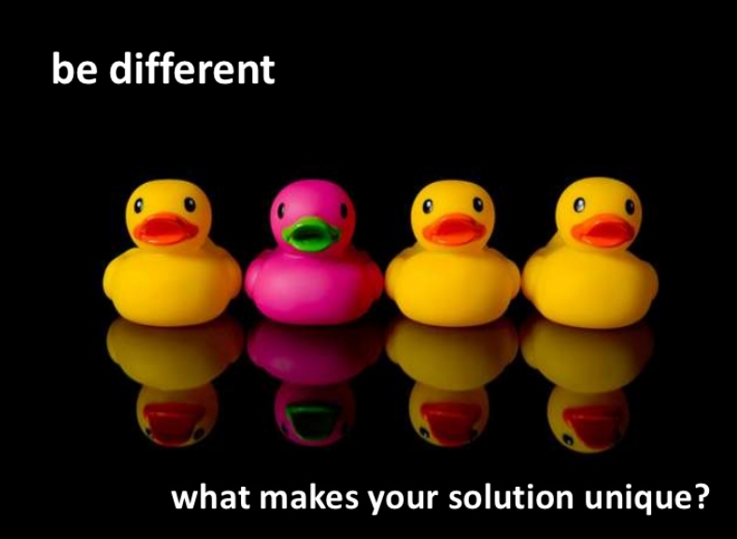


I am a Database Researcher!
As a Policeman, I…
As a Lawyer, I…
As a Firefighter, I do…

Slide 7
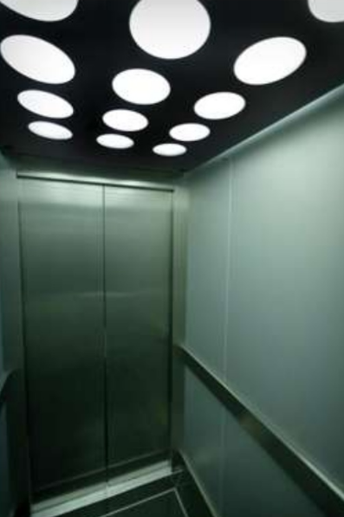
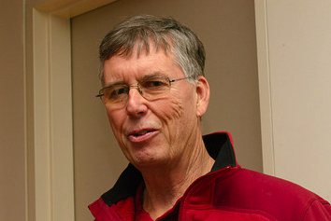

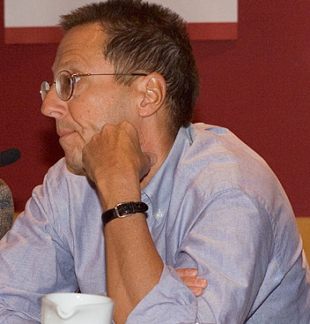
Elevator Pitch
Let’s Be Honest
She is. And by far.
Who is Tougher?

Slide 8
Think, how would you describe your typical working day in 3 sentences?

Slide 9
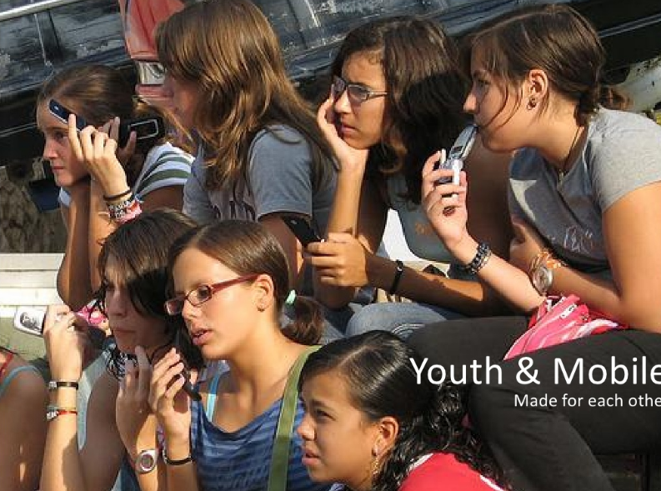
"that sounds incredibly boring, how can you sit at a desk all day and do that?"

Slide 10
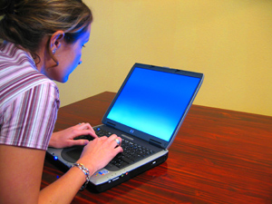

How do you
turn this
Into this

Slide 11

How do you spark the interest?

Slide 12
Back to Basics and Analogies

Slide 13
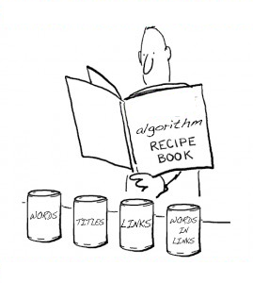
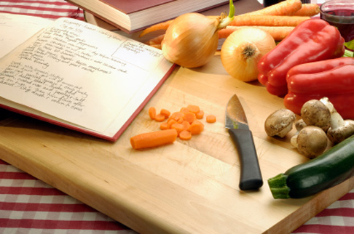
As Database Researcher,
You Design Algorithms
It is quite similar to writing a recipe for cooking…
only computers follow the instructions instead of chefs.

Slide 14
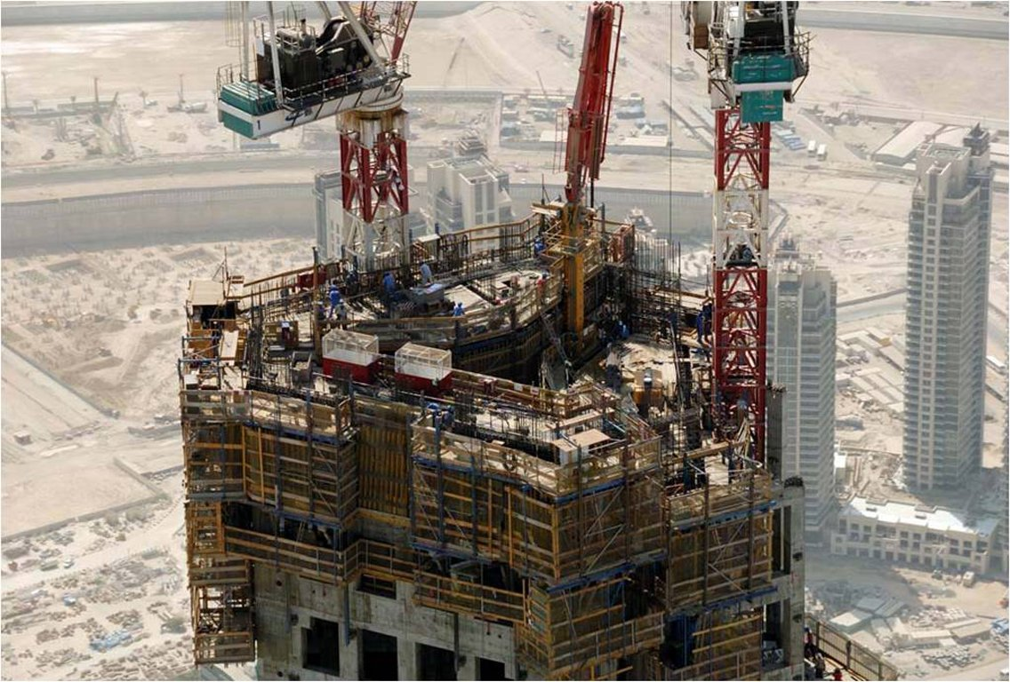
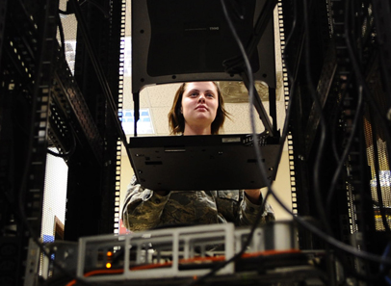
As Database Researcher,
You Program the Core of a System (or Application)
You are doing the brunt of the work, and more people will come after you to make it pretty.
It is like a construction worker putting together the skeleton of a building.

Slide 15
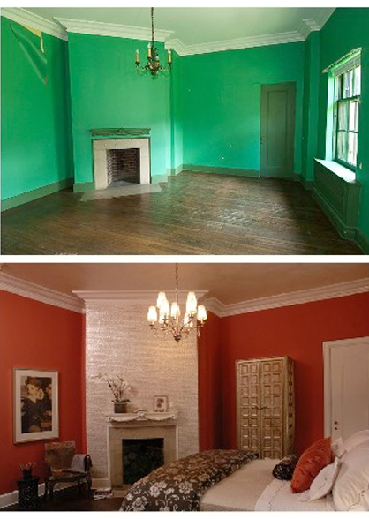

As Database Researcher,
You May Do UI Work
It’s like you are the interior designer for other artistically-challenged people.
You take the plain, bland building someone else has build and make it livable and usable for everyone else.

Slide 16

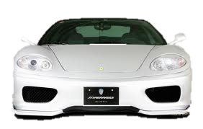
Car Analogy
They're both big, expensive machines which everyone has to have, everyone is expected to operate, few know how to really use 100% effectively, and very few know how to fix.

Slide 17

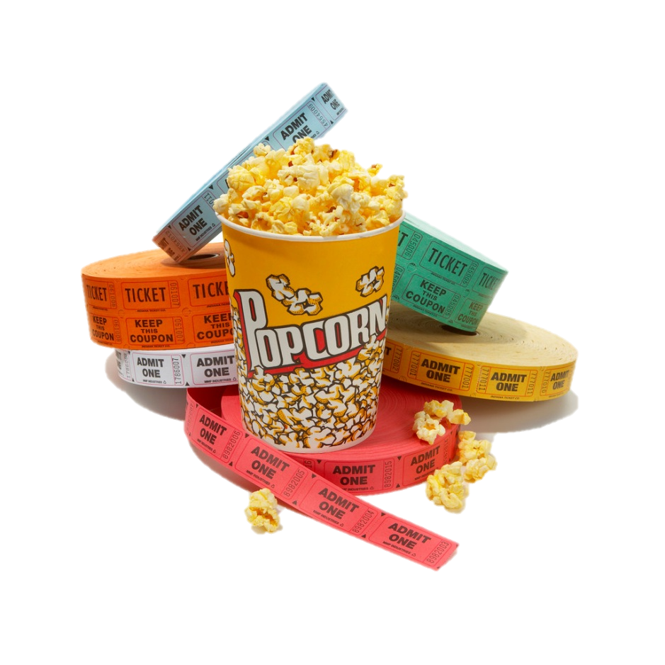
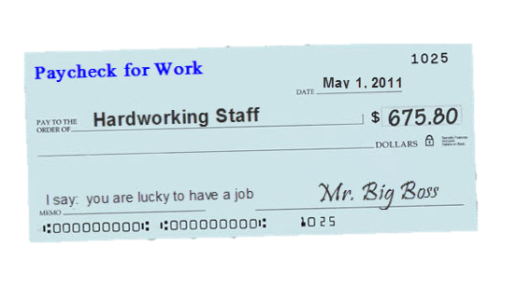
“If I mess up, what goes wrong…” analogy
"If I mess up, you can't get movie times on the web"
"If I mess up, nobody gets their welfare checks or paychecks"
"If I mess up, the wrong guy gets elected President"

Slide 18



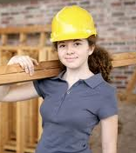



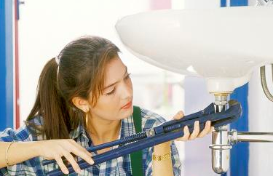
Put It Simply…
I know of no other job in the world where I can be…
an architect
a test pilot
a writer
on any given day
a carpenter
a detective
a plumber
a designer
an artist

Slide 19

Kids’ (common) Questions
Did you meet Bill Gates?
How much money do you make?
What did you want to be when you were in 8th grade?
When is next Xbox coming out?
Is your husband jealous?
Is your accent real?

Slide 20
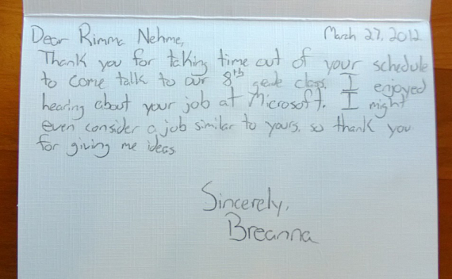
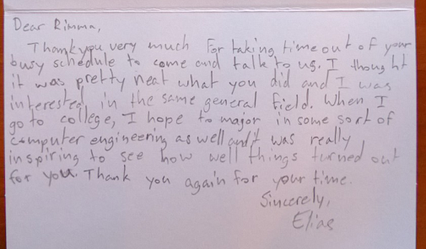
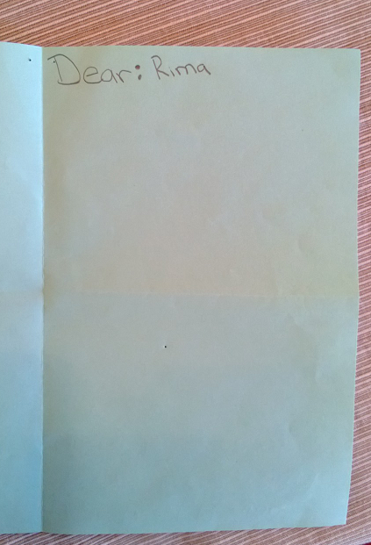
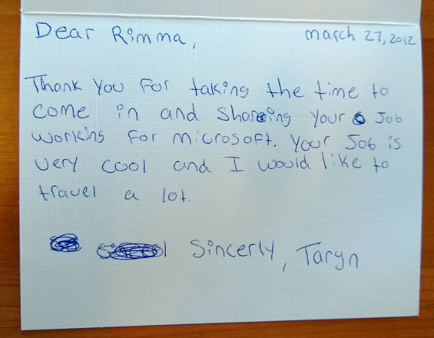
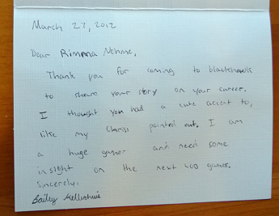
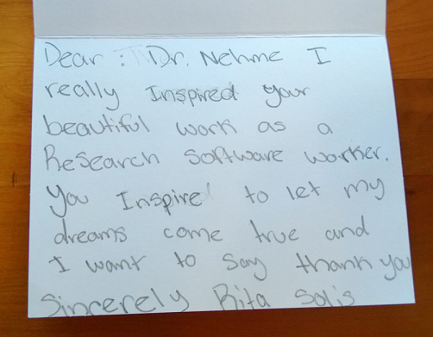
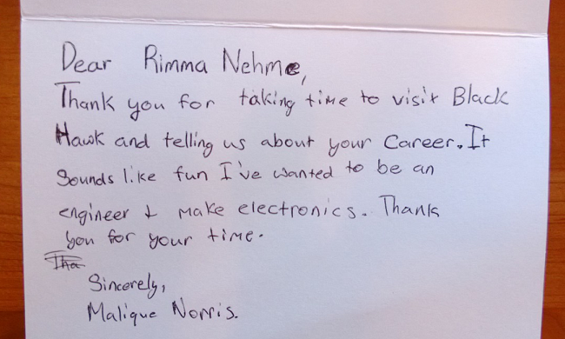
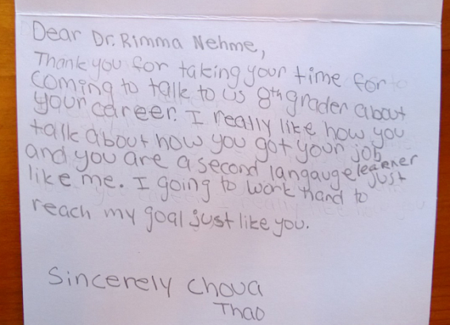
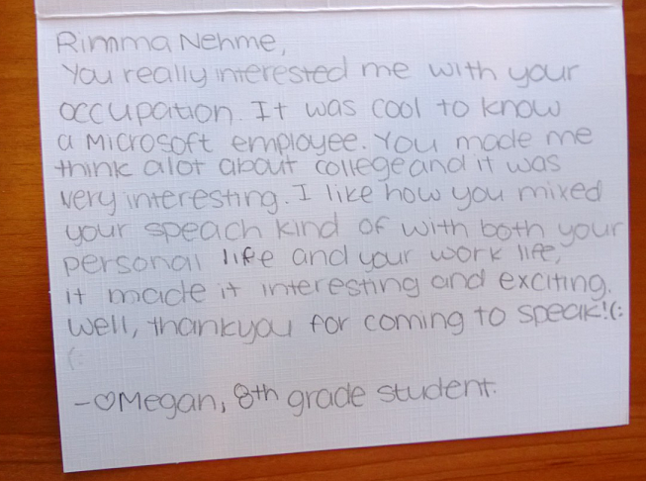
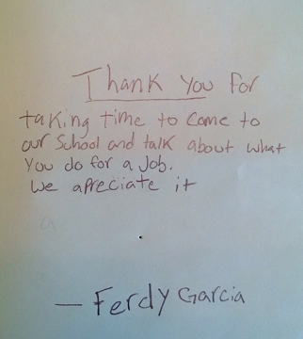
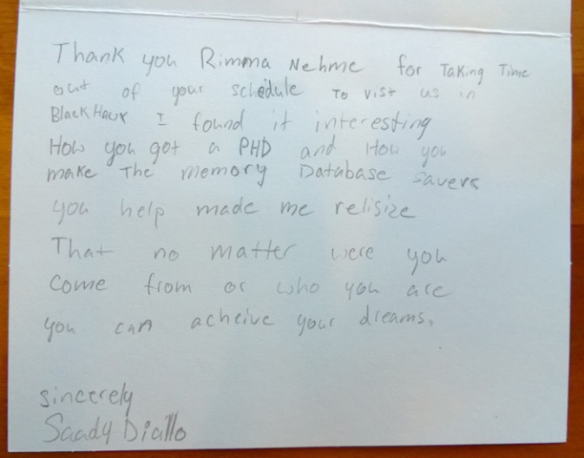
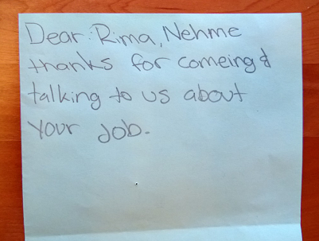
Some Responses…

Slide 21

Get out of the office and spend some time with children (even if you have yours at home)!!
So Why Am I telling you all this?
They have an extraordinary capacity to see into the heart of things and to expose sham and nonsense for what they are.

Slide 22


Remember…
Children are the living messages we send to a time we will not see. -- John W. Whitehead

Slide 23
Thank You

